Slide 1

Proposal for a New Value Delivery Model

Slide 2
Outline
Current State
Objectives
Benefits
Program Charter
Program Roadmap
Program Governance
Funding Plan
Project 1 Overview
Appendix: Strategyn Model

Slide 3
Current State
The value delivered by the ABA is difficult to identify and measure.
Business case for justifying legal investments is challenging to create without hard metrics around cost reduction, cycle time reduction, and value enablement.
The ABA resources are inconsistently positioned to influence the planning, investment, and execution around change.
Organizations do not know how best to use legal resources to mitigate risk and/or enable value for their customers and stakeholders.
Practitioners (lawyers) do not have a consistent way to assess the impact of their contributions (short term and long term).

Slide 4
Objectives
Create a reference model for defining the legal jobs from which duties, practices, and value are derived.
Build a repository of metrics that the ABA can use to measure the value that practitioners deliver to customers (governance).
Map the value metrics against the services (practices & methodologies) and products (tools & deliverables) used to deliver value to customers.
Identify opportunities (gaps between what is delivered versus what customers want) to improve services & products.
Identify products & services that the ABA can deliver to help:
Practitioners (lawyers) optimize their value delivery
Stakeholders leverage practitioners to optimize their value delivery

Slide 5
Benefits
Practice:
The practitioners (lawyers) will be able to justify the value of their services by creating measureable lineage from products & services to addressing customer needs.
Profession:
The ABA will be able to align the value gaps with its roadmap to ensure the practices, certification, education, and governance support the unmet customer needs for the products & services delivered by the practitioners (lawyers).
Public:
Enterprises will be able to understand the need, value, and positioning for the ABA to augment their own value delivery of products and services.

Slide 6
Program Charter
Program Charter | Developing a Legal Value Model
Project Number | ABA – 103 | Charter Date | October1st, 2009
Program Sponsor | ABA BOD BOT | Program Director | TBD
Program Scope | Design and implement a customer focus framework for capturing and modeling metrics used to model the outcomes for customers and a set of metrics for which to benchmark the products & services delivered by legal practitioners.
Objectives | Implement a customer focus methodology Create a reference model for identifying customer outcomes and metrics for measuring value Define a complete list of jobs performed by a lawyer Create a repository of customer outcomes & value metrics Develop a process to prioritize and align the outcomes & metrics with GAPS in ABA practices Institutionalize the customer focus methodology within ABA Develop a licensing program to promote the usage of Legal Value metrics & drive revenue for the ABA
Governance | Establish a steering committee with members from the BOD Create a small team of dedicated trained resources to staff each project Project lead will be the Program Director Steering Committee will approve scope, program objectives, and project deliverables (Note: Each project represents 1 job that will be studied to capture the legaloutcomes & value metrics

Slide 7
Program Roadmap
Q4 2009
Draft the proposal for the work stream
Obtain approval from ABA leadership
Build a steering committee for the program
Secure funding for the first project
Q1 2010
Continue securing funding for the project
Draft resources for the project team
Finalize project schedule
Begin work on initial deliverables

Slide 8
Program Roadmap
Q2 2010
Complete qualitative study for Project 1
Complete quantitative study for Project 1
Conduct analysis of Project 1 results
Q3 2010
Present Project 1 results to ABA leadership
Publish results for Project 1 to Public
Capture feedback and gauge response
Review program with Steering Committee for next steps
Secure funding for additional projects per program
Q4 2010
Move forward with next project(s)

Slide 9
Program Governance
BOT
BOD
Program
Steering Committee
Program
Director
ABA
CMO
ABA
CMO

Slide 10
Staffing Plan
Steering Committee
Jeff Wallk
Mark Lane
Greg Black
Marc Paradis
Mark Sternberger
Project Team
Jeff Wallk (commitment of 10 hours / week)
Volunteer 1 (commitment of 6 hours / week)
Volunteer 2 (commitment of 4 hours / week)

Slide 11
Project 1
(Overview)

Slide 12
Key Milestones & Deliverables
Qualitative Phase:
Job Study for Project Scope
Prioritize the jobs to study
Develop an interview plan
Conduct interviews (capture outcomes)
Analyze outcomes & complete analysis
Quantitative Phase:
Draft survey (using outcomes)
Conduct survey (measure outcomes)
Analyze results & identify opportunities
Present findings to Board of Directors (BOD)
Based on the Strategyn Methodology (see appendix)

Slide 13
Key Milestones & Deliverables
Establishing the opportunity pipeline
Prioritize the list of opportunities
Introduce tools for generating ideas (to address opportunities)
Conduct an open innovation competition (to generate ideas)
Steering Committee to select the best ideas
Provide recognition to contestants
Select the best ideas & agree upon list of recommendations to pursue
Present top ideas to ABA Board with recommendations
Transition ideas to innovation
Gain board approval to pursue recommendations
Board assigns ownership to develop & implement changes
Create new products & services
Modify existing products & services

Slide 14
Appendix
(Overview of Strategyn Methodology)

Slide 15
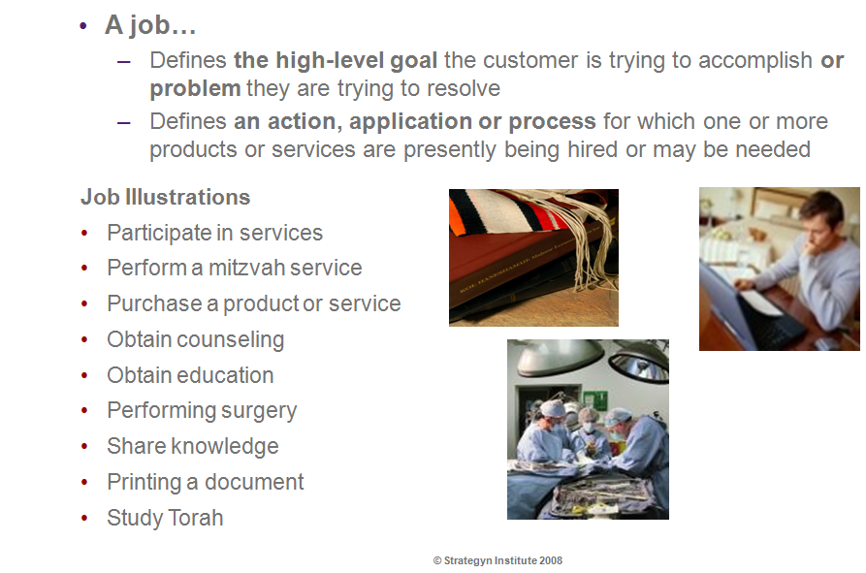
What is a Job ?

Slide 16
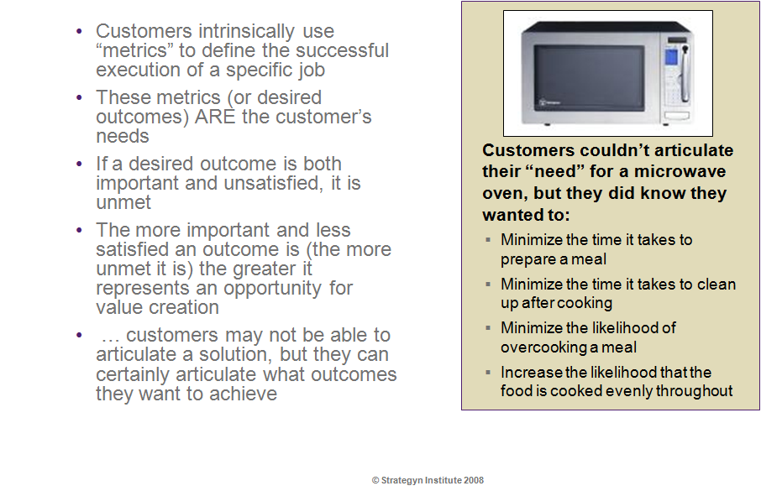
What are outcomes ?

Slide 17
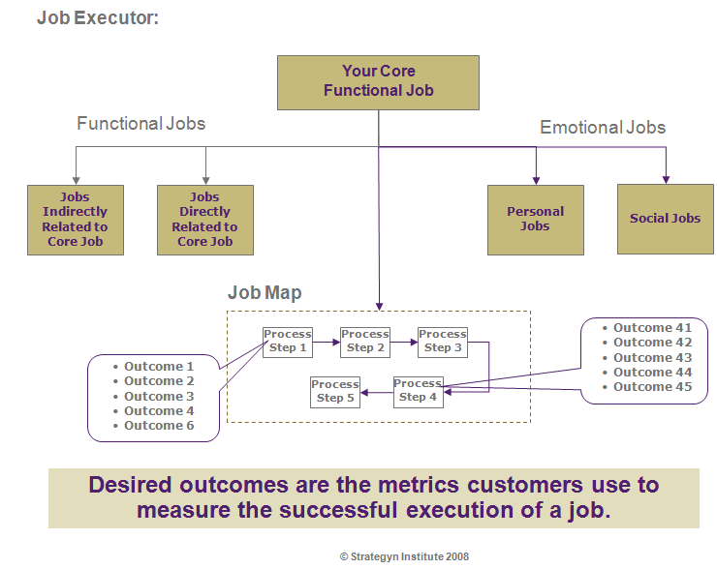
Model for Relating Jobs & Outcomes

Slide 18
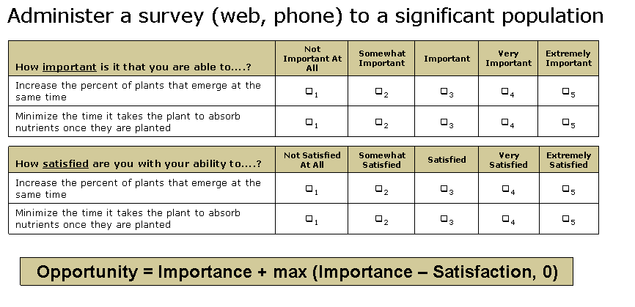
Capturing & Measuring Value

Slide 19
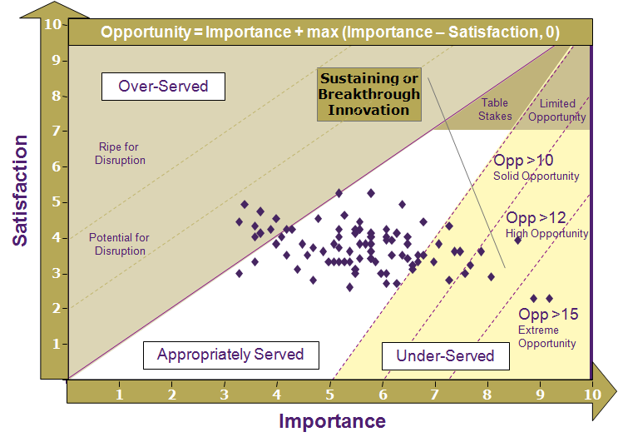
Identifying & Prioritizing Opportunities

Slide 20
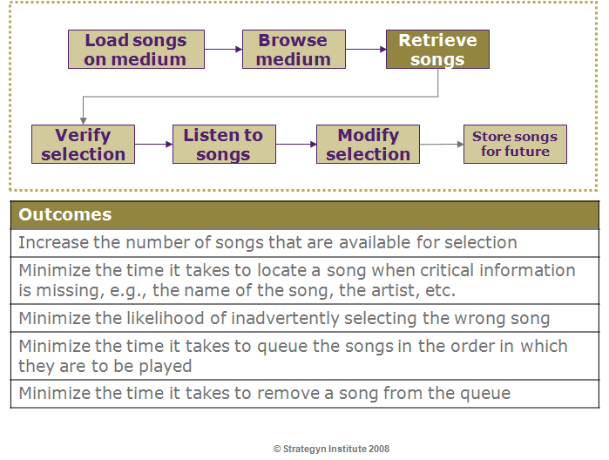
Example: Job of Storing & Retrieving Music

Slide 21
Thank You
Prepared by
Jeffrey Wallk (Managing Partner)
Helene Sigman (Principle Consultant)

